Slide 1

2nd Advanced Workshop on Blockchain: Technology, Applications, Challenges
Welcome to the
December 17, 2017
IIT Bombay, Mumbai, INDIA
SSID: IITB-Guest
User: iciss17.wifi
Pass: kw@bXv0LS

Slide 2



Thank you all for coming!

Slide 3
Outline
Session 1: Consensus Protocols
Session 2: Smart Contracts
Session 3: Security & Privacy
Session 4: Applications

Slide 4
Consensus!
A general agreement among the participants

Slide 5

We follow protocols to honor the agreements
Chaos
Trust but verify
Agreement = contract
Enforcer (Police)
Contract theory
  Complete
  Incomplete

Slide 6

Contract Specification
Sequence of pre-defined steps
Notes:
We follow certain logic.

Slide 7
Incomplete Contracts
contracts cannot specify what is to be done in every possible contingency
The hold-up problem

Slide 8
Executing Incomplete Contracts
In good faith…
With reasonable guarantee…
Under these circumstances…
Provided these conditions are met…
But who is going to verify?
  We rely on a facilitator (government, bank, et al)
  We trust! (voluntarily or forcibly)

Slide 9
Trust
Trust is the cornerstone of our relationships
  Whether in businesses, or
  In society, or
  With the institutions that govern us
    Governments
    Banks
Lack of trust has catastrophic repercussions
  2008 financial crisis, Zimbabwe
  The hold-up problem

Slide 10
Money, Currency & the History of Trust
Money = store of value
  Gold, silver
  Needs protection
  those who had the strongboxes and those who had strong moral fiber emerged as the custodians of people’s money and other forms of wealth
    Kings
    King’s treasury issues receipt for deposits made

Slide 11
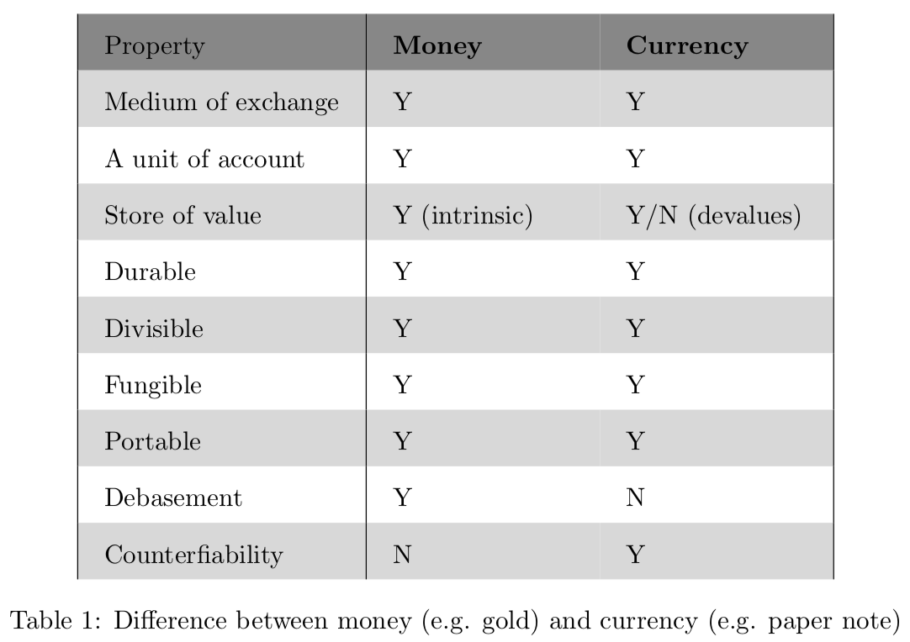
Money vs Currency

Slide 12
Currency
Currency = facilitator of exchange of value
  Gold coins, silver coins,
  Debasement
  1609, Bank of Amsterdam (standardization)
    Diminished incentive to debase
    City of Amsterdam became guarantor
    Full convertibility (on 100% reserve basis)
    Dutch East India Company (fractional reserve banking)
    This was one of the earliest steps toward modern fiat currency, generating notes that were only fractionally backed by metal deposits.

Slide 13
The Right to issue Currency
1694, Bank of England (private bank)
incorporated to allow William III to borrow 1.2M sterling
In exchange for a share rights offering of 1.2M sterling (that was then lent to the government), the bank gained the right to issue notes, including against the government bonds it had received.

Slide 14
Birth of Fiat Currency
1879, the US adopted the gold standard.
Having a currency backed by an actual precious metal helped lend credibility (trust) to the governments that issue it.
1933, US Congress nullified the right of citizens to demand payment in gold for their currencies.
1971, USD became a 100% fiat currency.

Slide 15
Fiat & The Supply of Currency
With the absence of a gold-backed dollar, US citizens inherited a fiat currency system backed by nothing but the trust in the government.
100% fiat currency = no redeemability into any commodity assets
USD is a global currency
U.S. law allows foreign central banks and several international organizations to maintain dollar-denominated deposit accounts at the Federal Reserve.

Slide 16
Trust in Internet Era
Internet changed the paradigm of commerce
Our ability to digitize information and transfer it across the globe, brought e-commerce
DNS – backbone of the Internet (trust)
Protection of digital information was paramount
Encryption technologies
  Symmetric & Asymmetric

Slide 17
Trust in Internet Era
X.500 (telephone directory)
X.509 (public-key directory, aka PKI)
PKI as TTP (DigiNotar fiasco)
PKIs are the fulcrum of e-commerce
Digital signatures

Slide 18
Trust in Internet Era
Physical ledgers with double-entry accounting evolved into digital ledgers with triple-entry accounting
Physical ledgers = digital ledgers
Double-entry accounting
Triple-entry accounting
Trusted third party as facilitator

Slide 19
Cypherpunks
The movement (of cryptographers, liberals)
PGP, web-of-trust, bottom-up approach (Phil Zimmermann)
Digital currency & double spending
eCash (David Chaum, blind signatures)
TTP to check double-spending

Slide 20
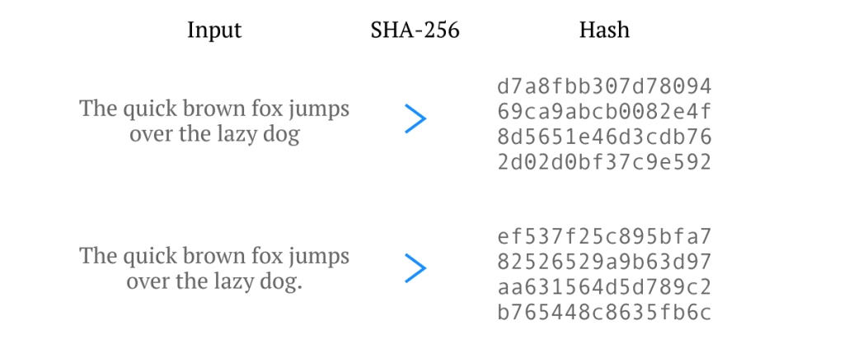
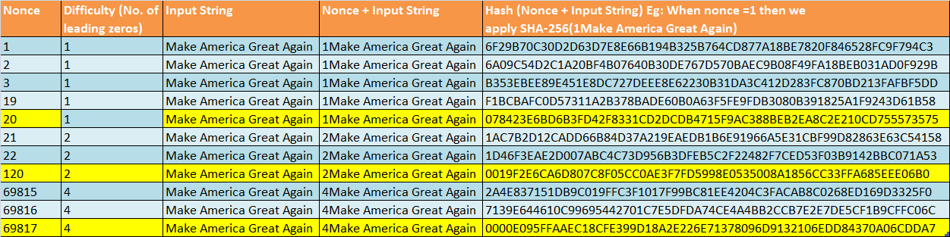
Cypherpunks
HashCash (PoW) – one way hash function

Slide 21
Cypherpunks
RPoW (Reusable PoW)
Bit-gold (nested PoW)
  Publicly set difficulty level
  Time stamping servers, Sybil attack
  Self-adjustment of difficulty level
  No limit on how much to be mined
2008, Satoshi Nakamoto, Bitcoin

Slide 22
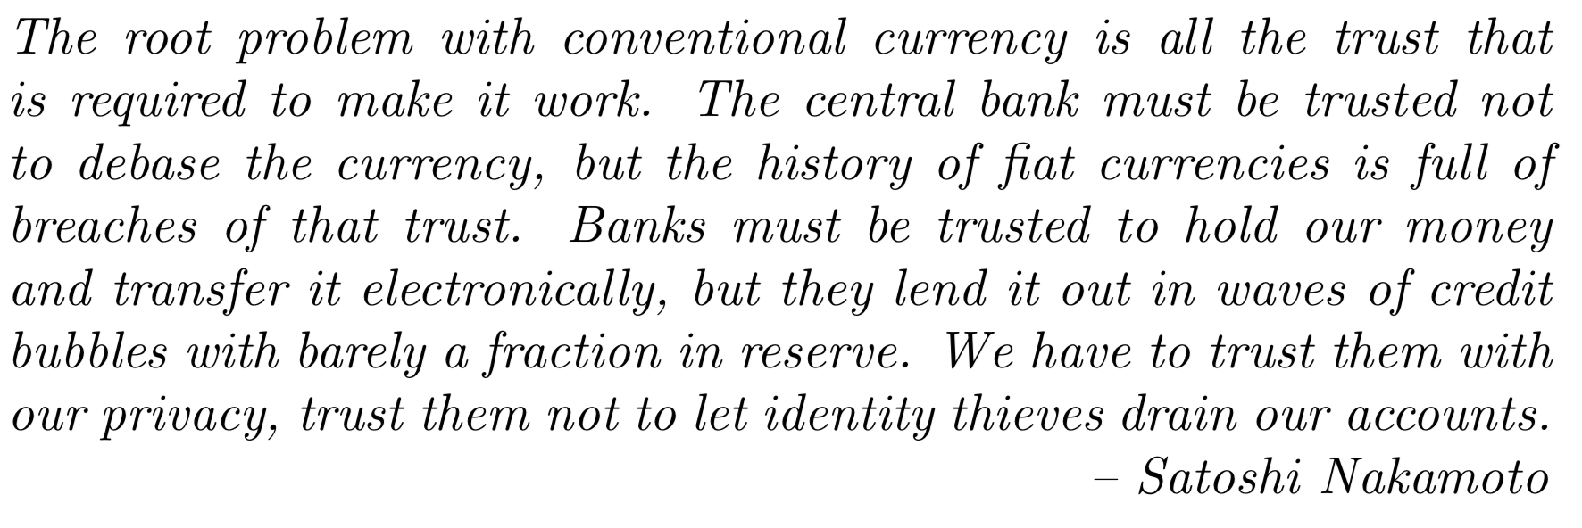
Bitcoin: A Peer-to-Peer Electronic Cash System

Slide 23
What Satoshi did is:
Satoshi managed to engineer the concepts of economics like scarcity, supply, demand, unit of work, incentive into computer science. At the core of all these concepts is unit-of-work: the universally acceptable and verifiable method to quantify a unit of work using computers.

Slide 24
Bitcoin
An ingenious way of using PoW, in P2P setup, to design an algorithm that:
  Periodically adjusts the difficulty of work
  Has a fixed supply of currency (incentive to work)
  Supports % of Computing power vs % of identities (Sybil)
The algorithm is central part of the protocol called blockchain
Bitcoin = bitcoin + blockchain

Slide 25
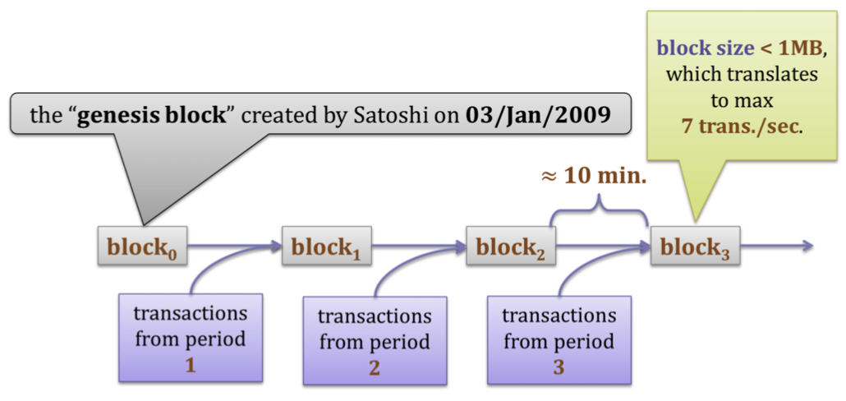
Blockchain

Slide 26
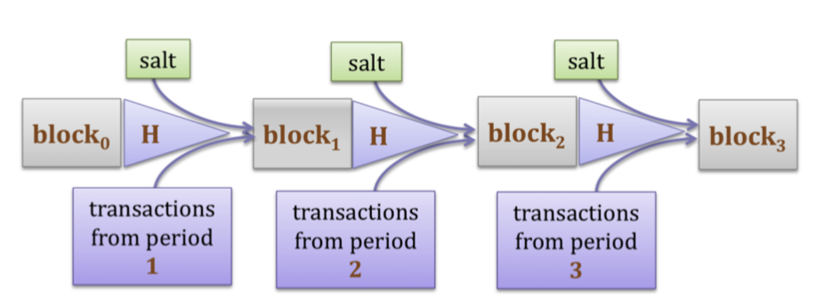
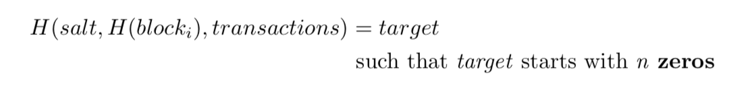
How PoW is used to sustain blockchain

Slide 27
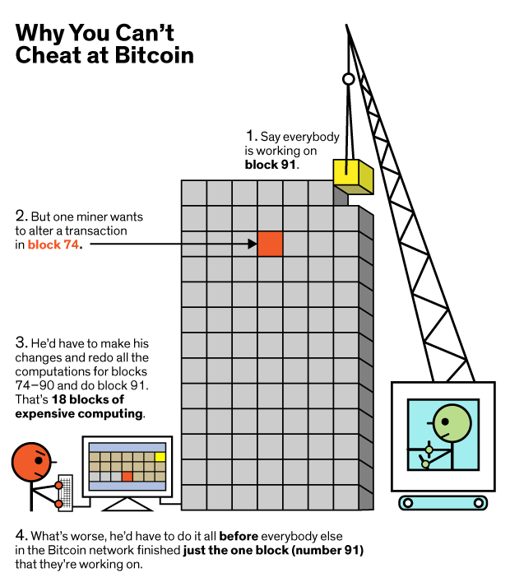
Difficulty in Revoking a Transaction

Slide 28
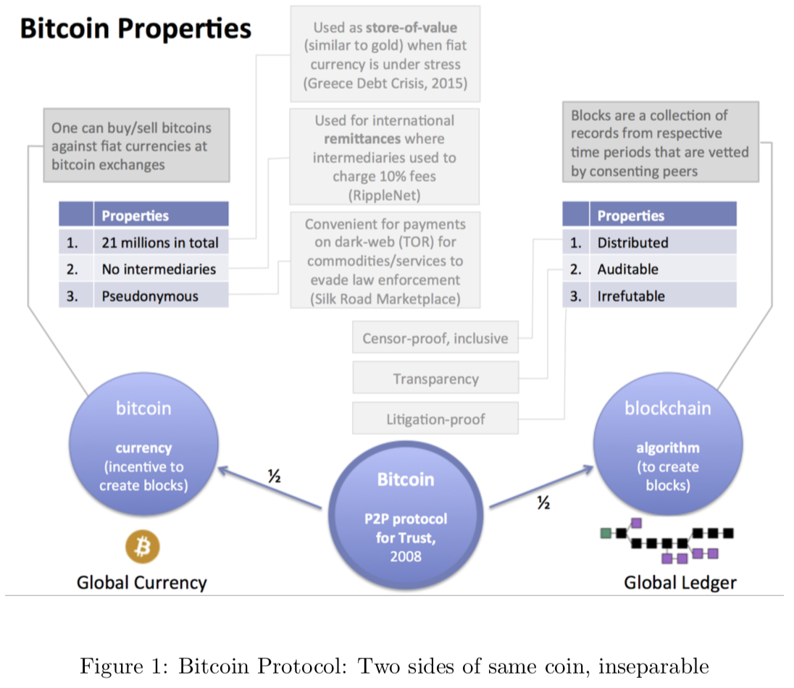

Slide 29
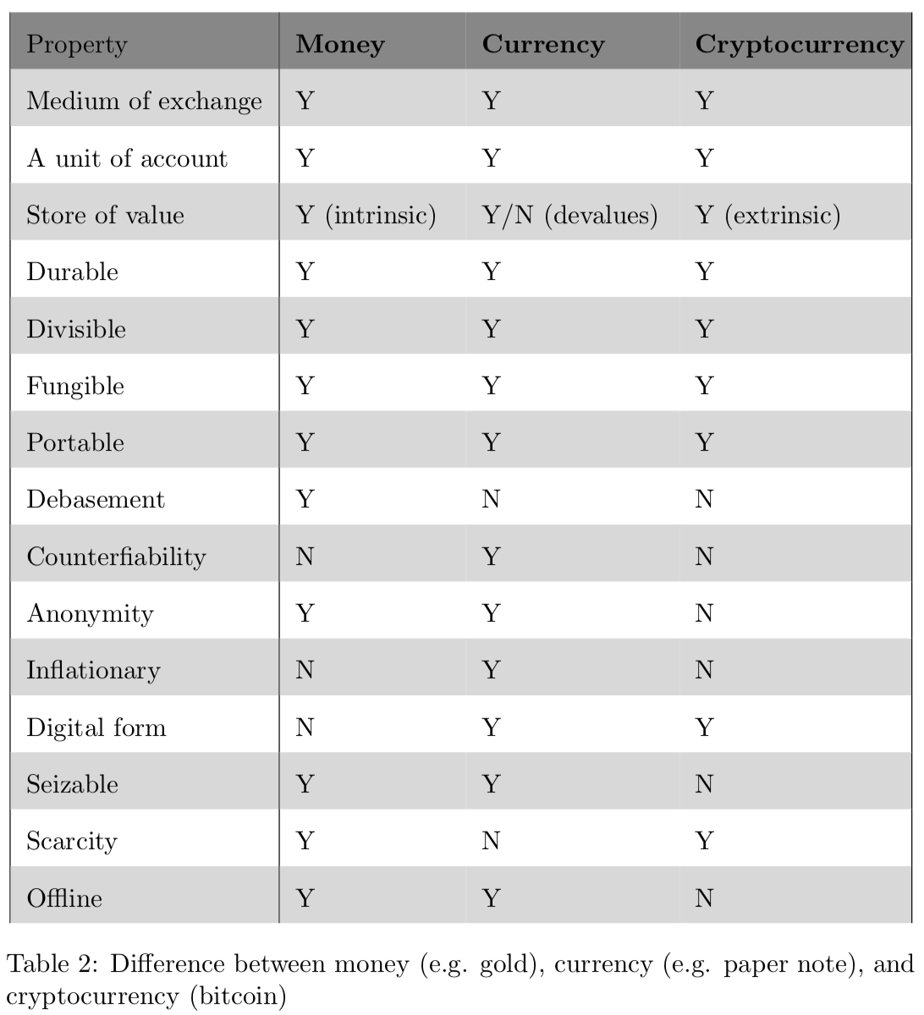

Slide 30
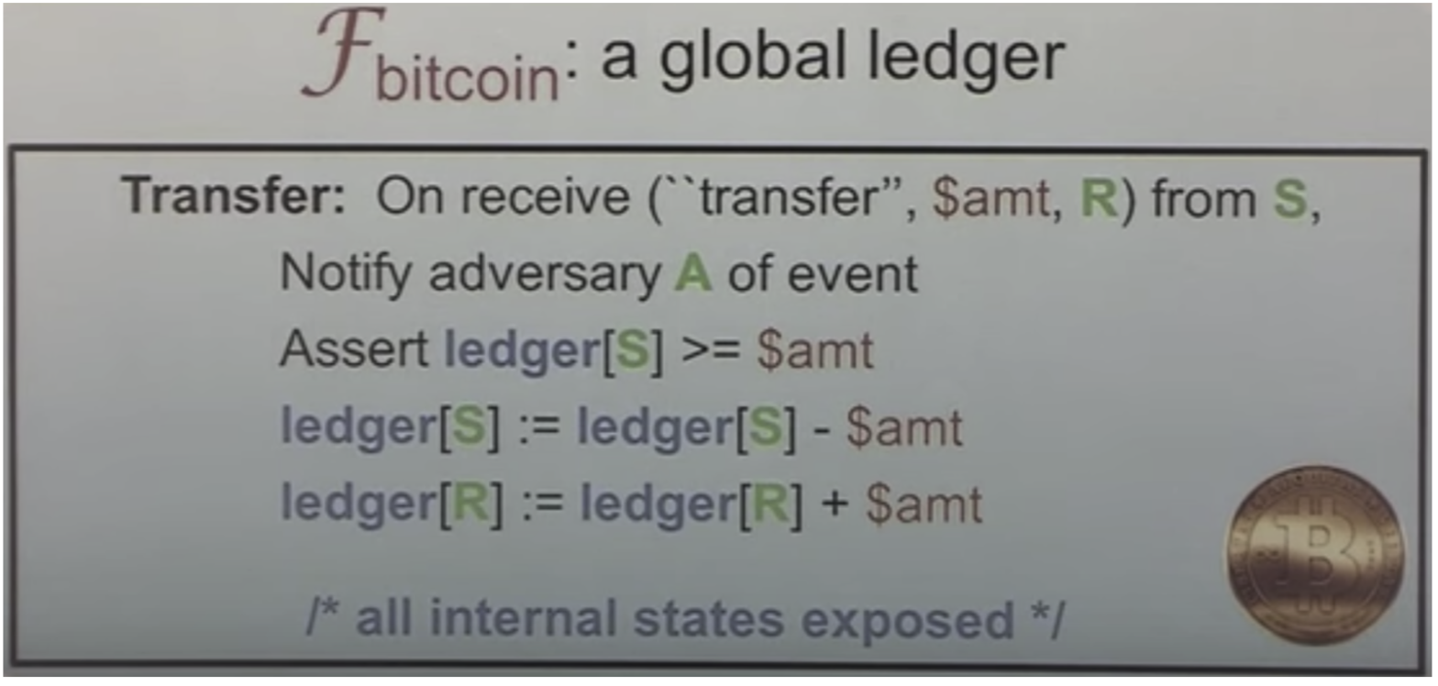
Global State Machine

Slide 31
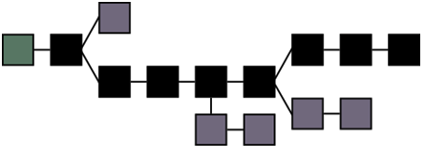
Blockchain

