Slide 1
koinearth
www.koinearth.com
Notes:
Music

Slide 2
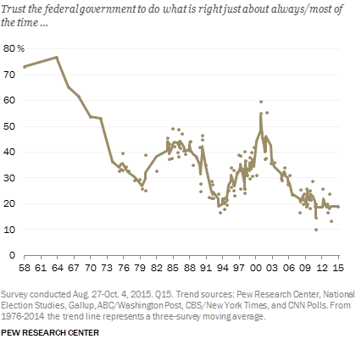
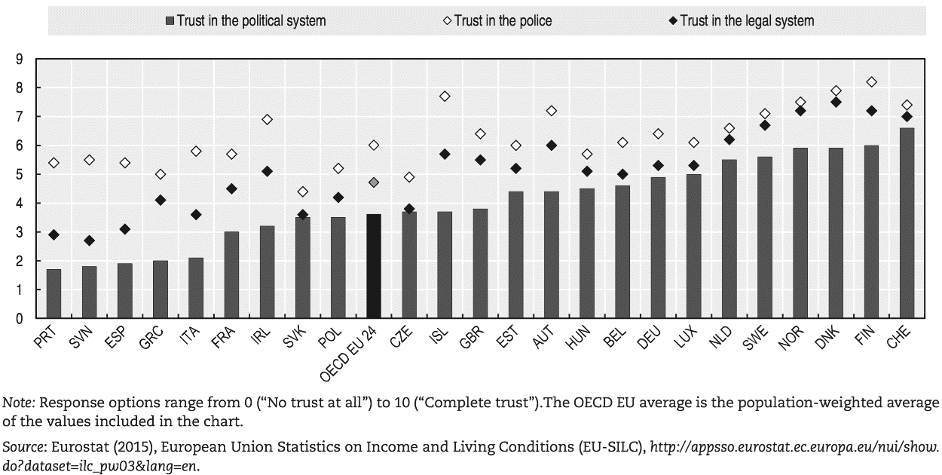
Problem Statement
Challenges of urbanism
  Stressed urban infrastructure
  Heterogeneous cultural backgrounds
    Variance in beliefs and preferences
    Non-trivial to create consensus / undertake community projects.
Trust in social institutions is falling worldwide
Can we create decentralized trustless social institutions?
e.g. Community governance
e.g. Civic Crowdfunding (voluntary taxation)
Notes:
Our solution is specially relevant in today’s urbanizing world.
With more than half the world’s population living in cities, urban infrastructure world wide is under extreme stress.
With cities becoming the dwelling center for people from heterogeneous cultural backgrounds, an urban culture is hard and slow to evolve. It is non-trivial to form consensus in such dense, diverse environments which makes undertaking community projects hard.
Combined with the fact that trust in formal social institutions is at a record low, urban environments pose a huge challenge for our times.
The problem we address is the creation of decentralized social institutions which empower communities to come together and solve their own problems rather than relying on formal institutions.

Slide 3
Impact
Empower groups to jointly invest in improving communities.
  A step towards community self-governance
Raise funding for community projects (public goods) by incentivizing individuals to contribute
  Contributions are treated as investments – they earn a return on their investment if the project is not funded.
  This approach is based on a recently proposed incentive mechanism in the research literature.
Reduces demand risk by confirming the demand for a particular project before its execution starts
  A project funded using our solution has the buy-in of the community and is thus more likely to succeed.
  As a ripple effect, it increases local government’s will to support projects which have been funded using our solution.
Build social capital in communities
  Brings communities together by making the project a focal point of social interactions in a community.
Notes:
Our civic crowdfunding solution enables communities to invest in themselves.
It allows anyone to propose and raise funds for a community project.
To incentivize individuals to contribute to a community project, we employ a recently proposed incentive mechanism.
By offering individuals an incentive to contribute to public projects they value, this mechanism ensures that a project which is desirable in the community, does in fact get funded.
More than generating funds for community projects, our solution reduces demand risk by confirming the demand for a particular project before its execution starts. We believe that this has the additional advantage of increasing ownership of the project in the community and consequently in creating support for it in local government.
It can also bring together communities as they work towards and benefit from the project.

Slide 4






Why Blockchain
Dis-intermediation
  Move trust from intermediaries to code (smart contract)
  Enables communities to collaboratively fund a project even when they are not physically co-located
Economic Mechanisms as Smart Contracts
  Blockchains provide a platform to implement incentives mechanisms as Smart Contracts
  This flexibility enables testing and refining of economic mechanisms
Performance Linked Payment
  Smart Contracts further act as escrow releasing funds to the project proposer based on achieved progress
  Smart Contracts interface with a sensor-based oracle (via oraclize) to determine project progress
Notes:
Using blockchains to create social institutions like civic crowdfunding offers 3 key benefits.
By codifying the terms of social interaction in Smart Contracts, our civic crowdfunding solution allows individuals to co-ordinate their preferences and funds towards a common good. A blockchain based solution thus creates a decentralized voluntary taxation institution without intermediaries.
For us at koinearth, Smart Contracts are the perfect platform to implement, test and refine incentive mechanisms which lie at the foundation of social institutions.
A further benefit of our Smart Contracts is that after the funding process has completed, they act as an escrow and use sensor based oracles to support disbursal of collected funds based on project progress.

Slide 5
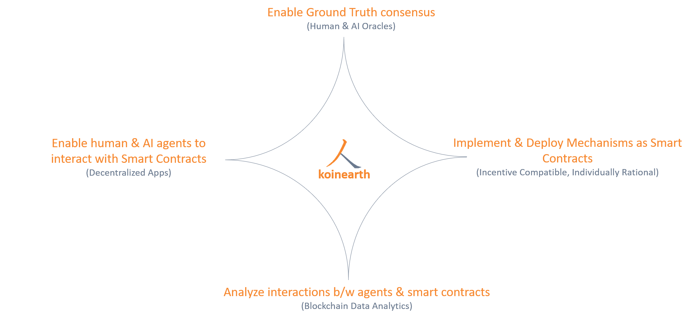
High Level Overview

Slide 6


Evolution : How we did it?
Mechanism Design
  Design incentive mechanisms for the private funding of public (non-excludable) projects
  Provision Point Mechanism with Securities: Ensures that projects valued by the community are funded.
Smart Contract
  Implement incentive mechanisms as Smart Contracts
  Factory Contracts to spawn Smart Contracts on demand.
Decentralized Application
  Dapp to interface with Smart Contracts
  Project proposer: Create campaign for raising funds
  Community investor: Invest in community projects
Oracle
  Interface Smart Contract with IoT oracles to measure progress
  Smart Contract disburses funds to proposer based on oracle-reported progress
Notes:
The origins of our journey lie in game theory. In 2016, one of the team members proposed the PPS mechanism for the private provisioning of public goods – fundamentally a taxation substitute.
Based on the positive response and encouragement from the research community, we were encouraged to implement this mechanism as a Smart Contract on the Ethereum Blockchain.
The development of a Dapp which can interface with this Smart Contract followed subsequently.
Building on the trustless philosophy of Blockchains, we further enhanced our Smart Contracts to act as an escrow which can interface with sensor based oracles.

Slide 7

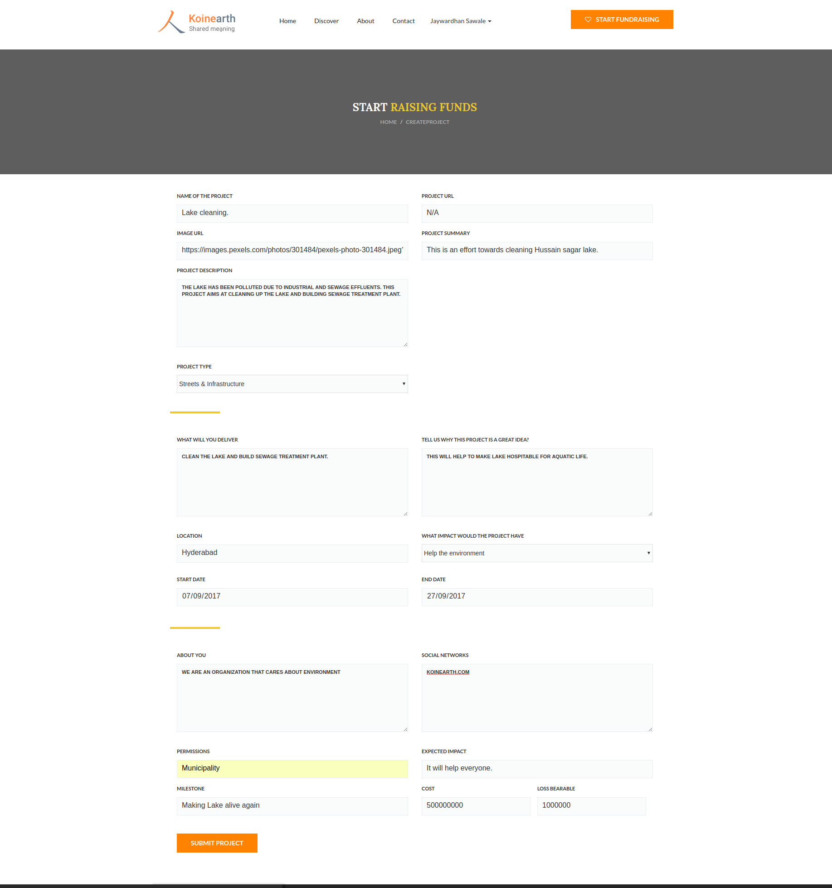
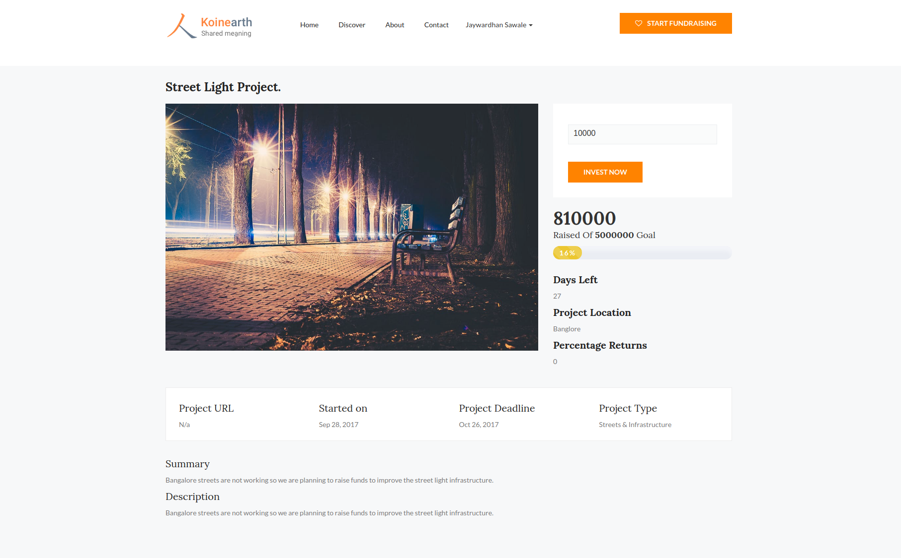
Proof of Concept
Design
  Project proposer spawns civic crowdfunding Smart Contract
  Contributors use cryptocurrency to fund project via Smart Contract
  Post funding deadline, Smart Contract acts as Escrow
  If project is funded, contributions released to proposer
    Milestone based fund disbursal
    Milestones verified by IoT oracle
  If project is not funded, contributions refunded with bonus
Notes:
Our solution’s design consists of a Dapp, a Smart Contract and an Oracle which interfaces with the Smart Contract.
For civic crowdfunding, creating a proposal for a community project results in spawning a new Smart Contract on the blockchain. Creating a project and the corresponding smart contract requires the project proposer to fill out some basic details like what the project is proposing to do, the amount of wei or ethers that he wants to raise and the deadline by which he wants to raise these.
This smart contract acts like a crypto vault, from which amount can be withdrawn when certain conditions are met.
Once the smart contract associated with the project is deployed on the blockchain network, anyone can contribute to it. Investments towards the project lead to transactions between an individual’s wallet and the Smart Contract.
After the deadline for the fundraising is reached, the Smart Contract acts as an escrow.
If the project succeeds in raising the target amount, the collected amount is released to the project proposer in a phase-wise manner based on progress achieved by the project. In the current implementation, the project progress is as reported by a sensor based oracle. On the other hand, if the project is not able to raise the target amount, the investments are refunded to the contributors and an additional bonus is paid to them. It is this refund bonus proposed by the PPS mechanism that solves the free riding problem by incentivizing agents to contribute towards the project - contributors earn a part of this refund bonus on their investment if the project is not funded. The key idea behind the mechanism is to ensure a win-win situation for the contributors. If a community member contributed towards a project and the project succeeds in achieving the target funding, then (s)he benefits from the provisioned community project. If the project fails to raise the target funds, (s)he benefits by getting a return on her investment.

Slide 8
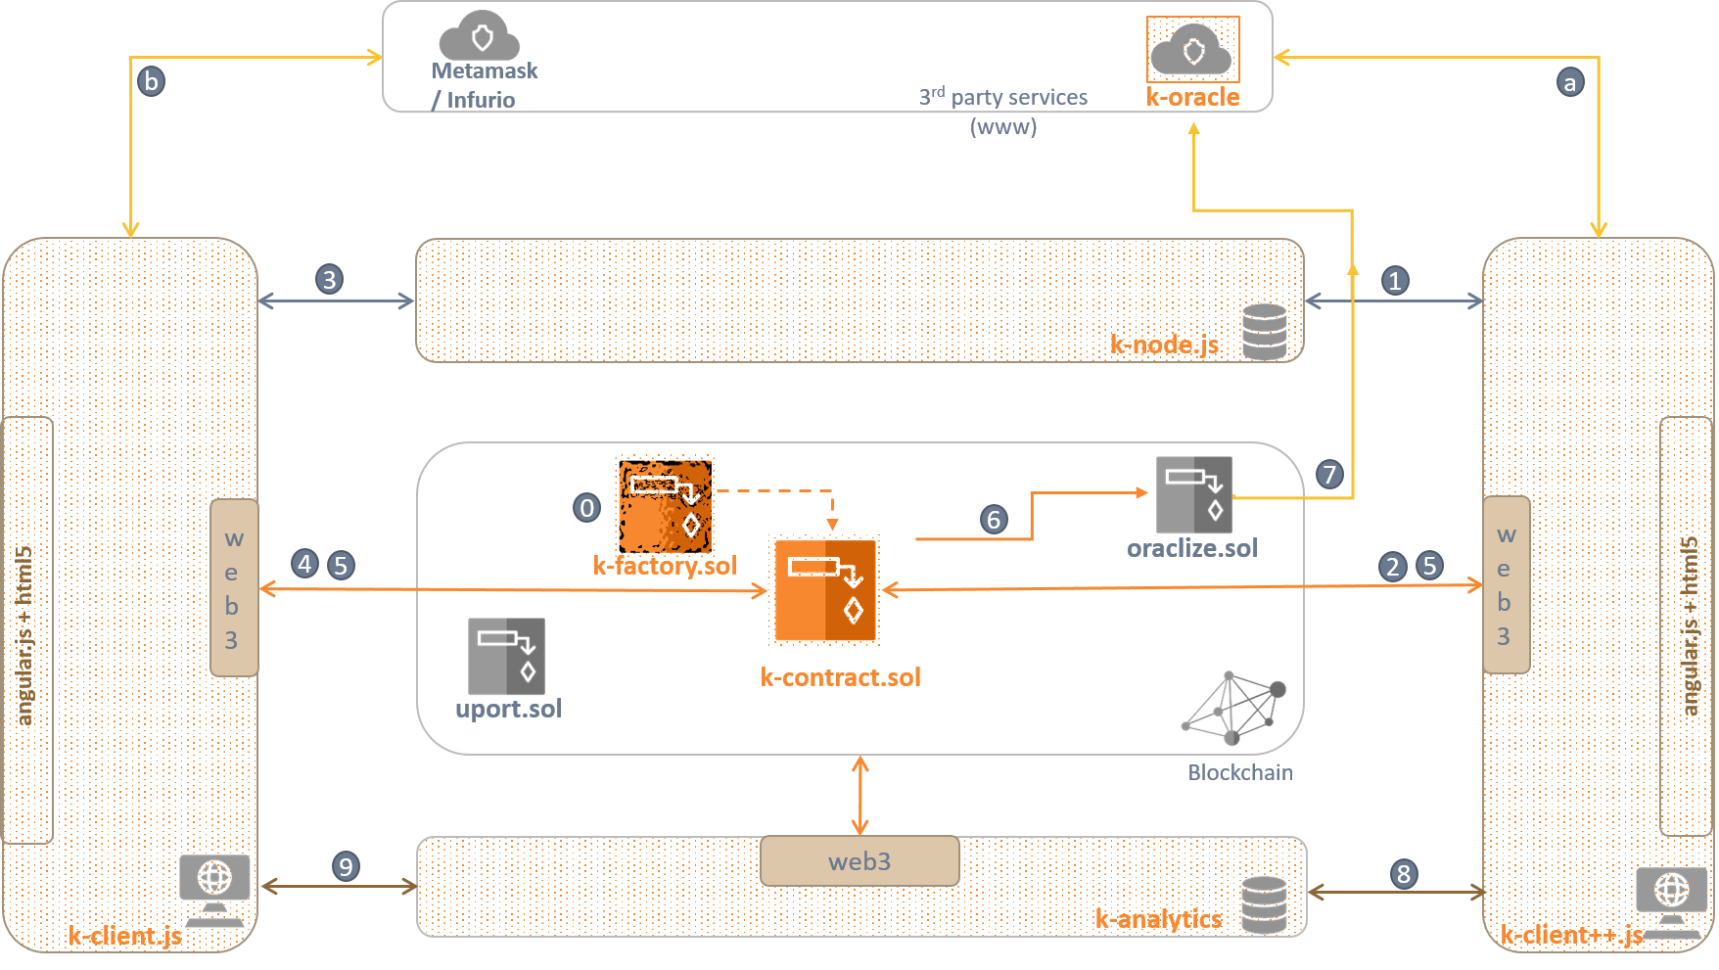
Proof of Concept
Notes:
Our solution’s design consists of a Dapp, a Smart Contract and an Oracle which interfaces with the Smart Contract.
For civic crowdfunding, creating a proposal for a community project results in spawning a new Smart Contract on the blockchain. Creating a project and the corresponding smart contract requires the project proposer to fill out some basic details like what the project is proposing to do, the amount of wei or ethers that he wants to raise and the deadline by which he wants to raise these.
Once the smart contract associated with the project is deployed on the blockchain network, anyone can contribute to it. Investments towards the project lead to transactions between an individual’s wallet and the Smart Contract.
After the deadline for the fundraising is reached, the Smart Contract acts as an escrow.
If the project succeeds in raising the target amount, the collected amount is released to the project proposer in a phase-wise manner based on progress achieved by the project. In the current implementation, the project progress is as reported by a sensor based oracle. On the other hand, if the project is not able to raise the target amount, the investments are refunded to the contributors and an additional bonus is paid to them. It is this refund bonus proposed by the PPS mechanism that solves the free riding problem by incentivizing agents to contribute towards the project - contributors earn a part of this refund bonus on their investment if the project is not funded. The key idea behind the mechanism is to ensure a win-win situation for the contributors. If a community member contributed towards a project and the project succeeds in achieving the target funding, then (s)he benefits from the provisioned community project. If the project fails to raise the target funds, (s)he benefits by getting a return on her investment.
More details about the implementation are available in the accompanying documentation. We now move to a demo of our solution. A live demo is also available on request.

Slide 9
Challenges
Platform
  Limited transaction throughput
  Asynchronous nature of platform
  Evolving development tools
  Near absence of test and formal verification framework
Smart Contract
  Security assessment of smart contracts(currently manual)
  Limited mathematical operations (log,float)
  Random number generation
  Evolving design patterns
Dapp
  Privacy and KYC
  Wallet security and portability
  Dapp on mobile platforms
Notes:
Limited transaction throughput - Ethereum supports 20, visa 1667 transactions per second. An application like crypto kitty can flood the network.
Asynchronous - Stand alone this is not a problem. But add it with slow transaction throughput, a user has to wait for a long time for transaction to be confirmed. This leads to Bad UX. When user spawns a new project she has to wait for few seconds to get a confirmation.
Evolving dev tools - The development tools are still in evolving phase. eg. - Linters are slow and not intuitive.
There is no framework for Dapp testing, integration testing.
security assessment - No tool that points to potential security threats automatically. Currently has to be done manually.
Mathematical operations like log are not available. Floating point operations support is absent. We had difficulty for calculating logs in Logarithmic Scoring Rule for implementing PPS.
Since everything is open on blockchain, there is no full proof solution for random number generation. We faced difficulty in designing oracle which required a random number.
Because of distributed and open nature of the platform, conventional design patterns do not work as it is. They need to be tweaked for BC based solutions. eg. - For creating new project on BC we had to tweak factory pattern.
Privacy on the BC is that public key is anonymous identity. But in the setting where public key and off chain identity mapping is required, privacy problem gets a new angle. eg. - Govt insists on KYC before token allocation.
Because geth client is required to talk to BC, Dapp cannot be directly ported to a mobile. Tools like infura are available, but they have limited support. eg - infura does not support listening to events.

Slide 10
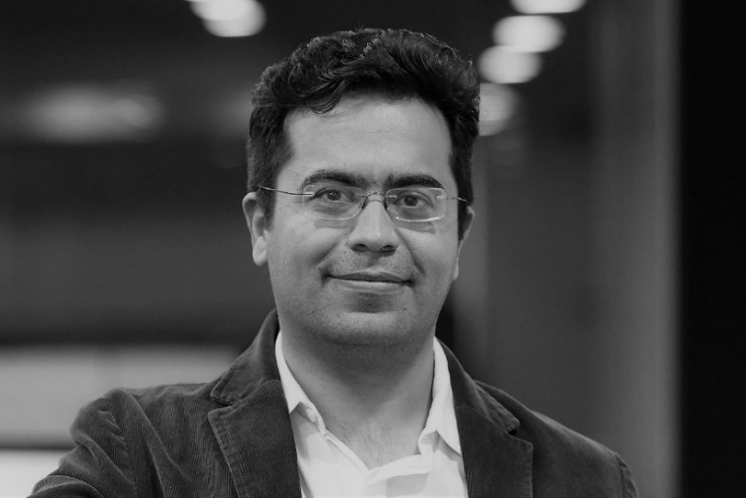
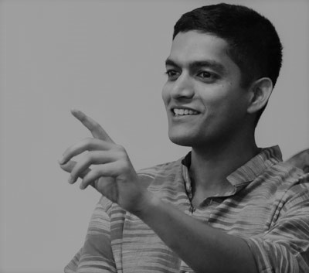
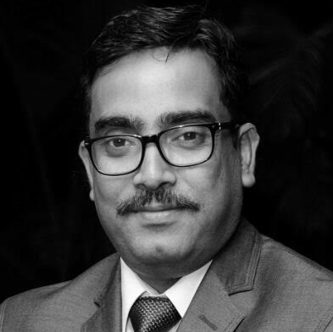
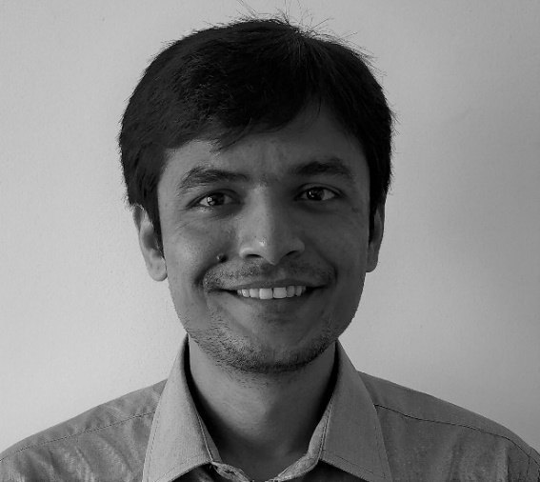

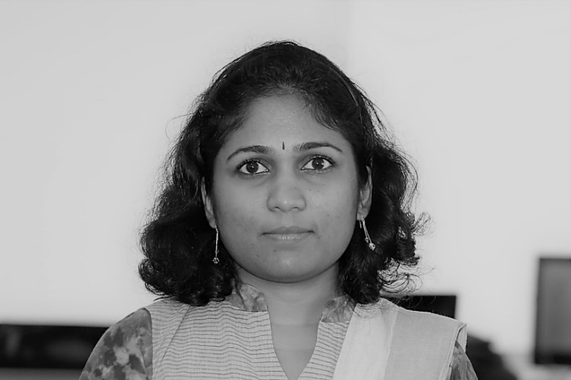

Team
Dr. Praphul Chandra
Dr. Surya Komapalli
Amit Ranjan
Jaywardhan Sawale
Gaurang Singh
Lakshmi Rajasekhar
Hrishi Wadki

Slide 11
Contact us
www.koinearth.com
praphulcs@koinearth.com
amitr@koinearth.com
jayawardhans@koinearth.com

