Slide 1


XinFin Blockchain for global Trade and Finance
Workshop on Blockchain: Technology, Applications, Challenges
17 December 2017
XinFin Fintech Pte. Ltd.
Singapore
www.XinFin.org

Slide 2
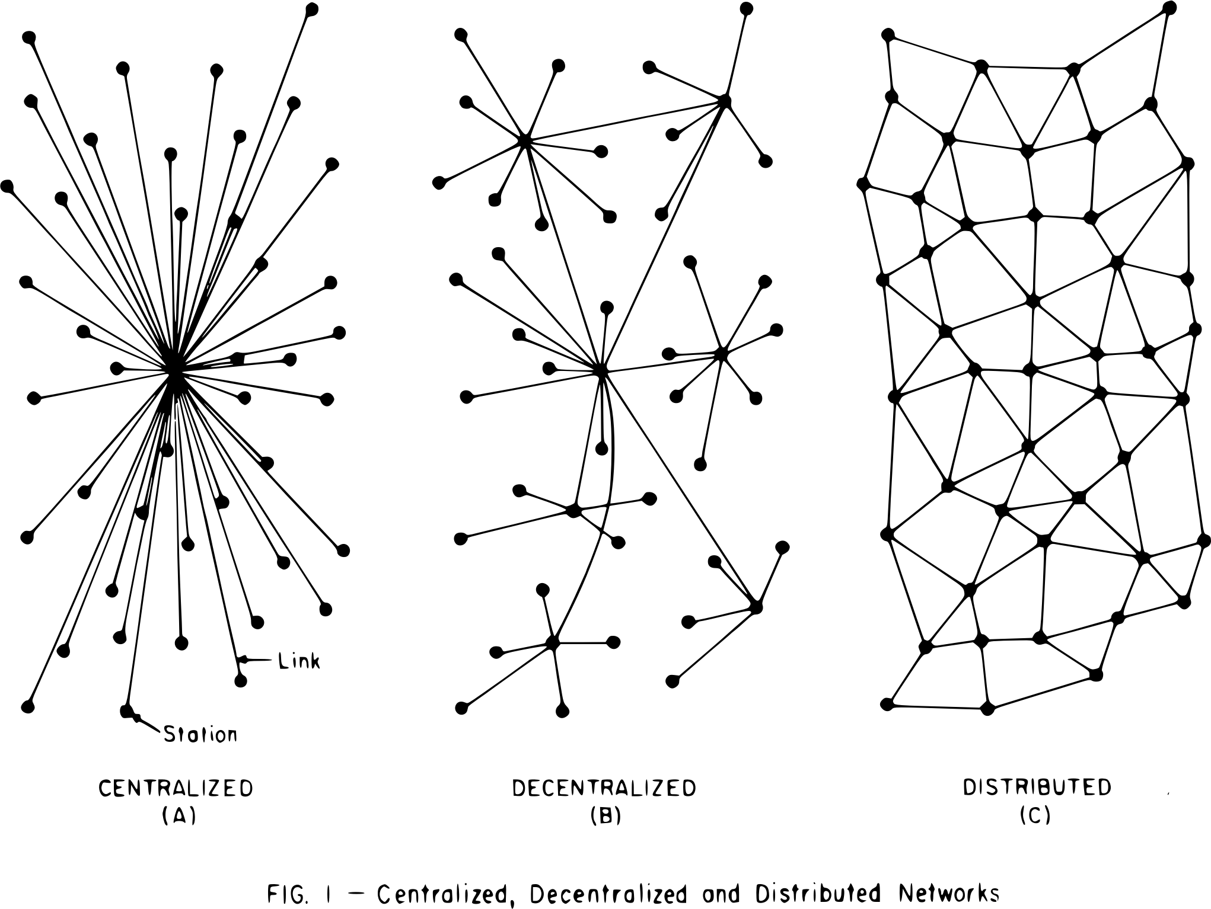
What is “Decentralized”? What is “Distributed”?
Every discussion in the blockchain space is around ‘decentralized’ or ‘distributed’?
'Decentralized' and 'Distributed' are, strictly speaking, not quantitative terms.
We don't want to define these terms
too accurately.
Why is the argument for
decentralization in the blockchain
space important?

Slide 3
Three kinds of decentralization
Technological Decentralization: When processing is spread over a number of nodes(computers).
Authority Decentralization: The control of the processing hardware(computers) by a number of independent individuals or organizations.
Ecosystem Decentralization: When the system is symmetric

Slide 4
Centralization and Public Blockchains
Token Issuer
Post listing
Token Issuers hosts master nodes
Exchange(s)
Private placement / ICO
Post listing
Purchase / Encashment
………
Participant 1
Participant 2
Participant n
Participants
……..
Application 1
Application 2
Application n
Applications and POS

Slide 5
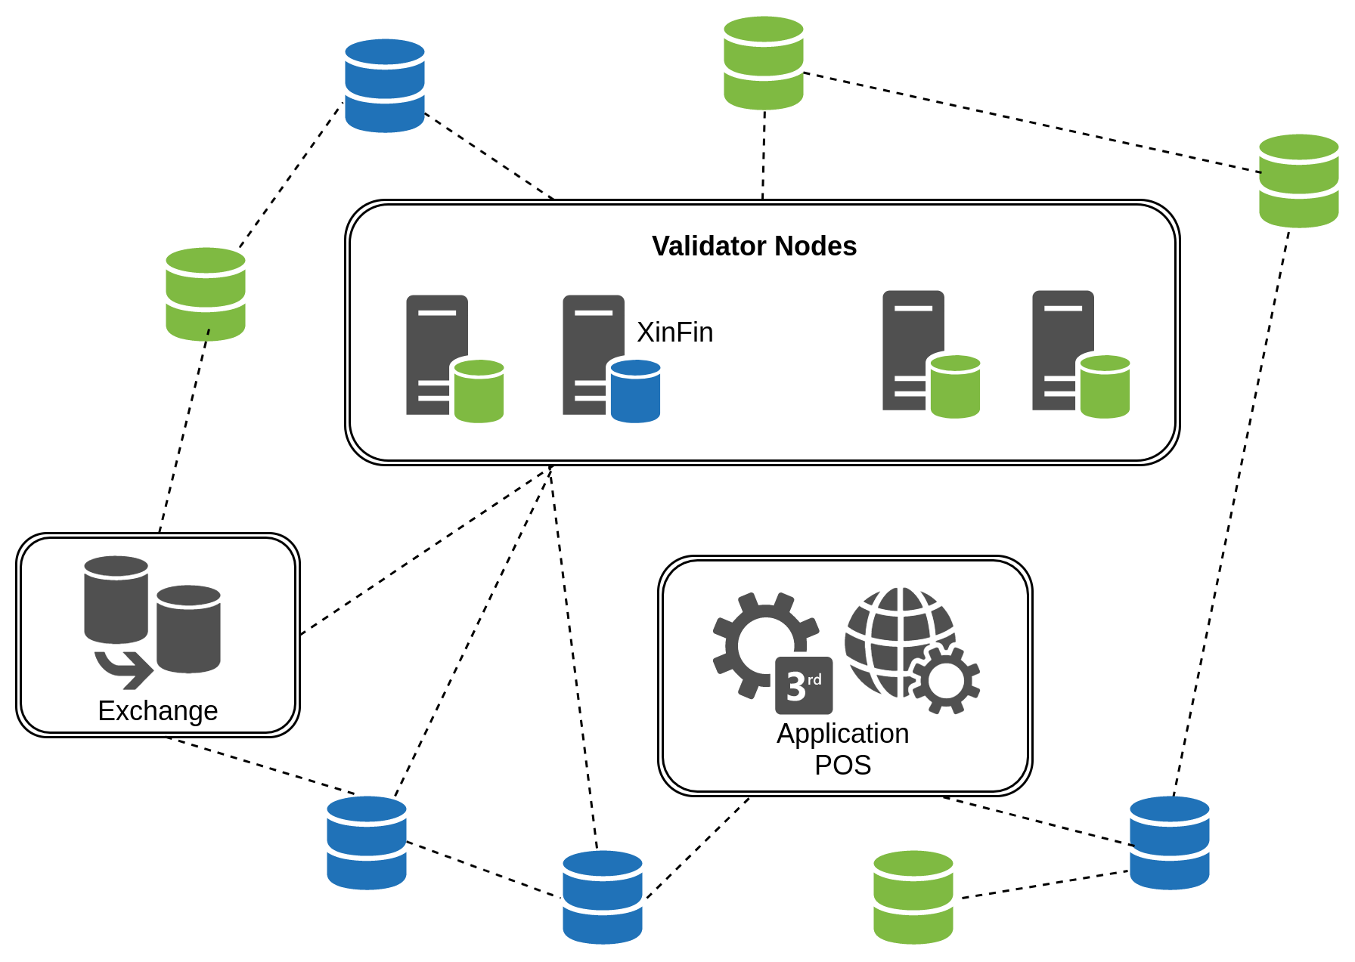
The XDC Blockchain Ecosystem

Slide 6
XinFin and its ecosystem ensures a better decentralization using its hybrid blockchain
Institution 1
Institution 3
Token Issuer
Institution 2
Institution N
Post listing
Several institutions host master nodes
Exchange(s)
Private placement / ICO
Post listing
Purchase / Encashment
………
Participant 1
Participant 2
Participant N
Participants
……..
Application 1
Application 2
Application N
Applications and POS

Slide 7
XinFin Blockchain platform uses PBFT derived consensus mechanism
Consensus levels
Protocol level
  Permissioned entities take part in the consensus process
  Validator/ full nodes add new blocks to the XDC blockchain
Platform level
  Membership by stake ownership
  Stake driven eligibility to take part in the consensus process
  Punitive conditions in place to prevent fraudulent transactions (Asset seizure, penalties, etc.)
  Permissioned participation ensures agreement and correctness of the XDC network

Slide 8
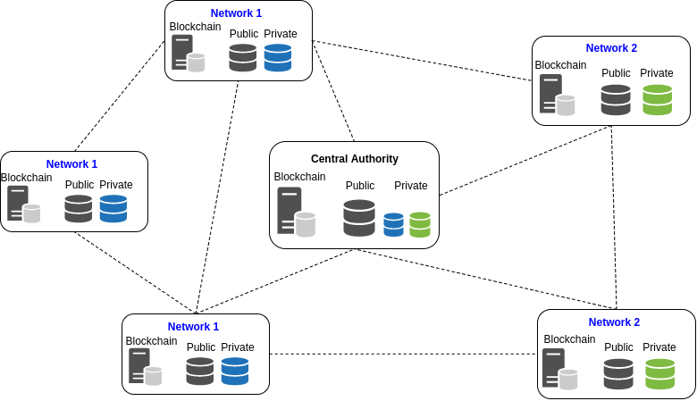
XinFin Hybrid Blockchain: A Public and Private blockchain
Network 1
Network 2
Network 1
Master Nodes
Network 1
Network 2
XinFin Hybrid Blockchain
Public Blockchain
Easily available
Large Developer Community
Higher participation due to open source code
Protection from one single entity possessing majority control over the network
Private Blockchain
Secure and private transactions
Trusted validators
High Throughput
Scalable
Cost effective operations

Slide 9
XDC Blockchain platform will offer three types of memberships to participants
 | Tier-1 | Tier-2 | Tier-3
Target participants | Retail users | Corporate – Small and Medium enterprises | Corporate – Financial institutions and large enterprises
Membership criteria | Default membership after opening wallet account | Stake driven | Stake driven
Consensus | Do not participate | Proportional to their stake | Proportional to their stake / full validators
Role | Trading | Trade, Finance, limited validation and limited private network capability | Trade, Finance, validation and full private network functionality

Slide 10
There are multiple Blockchain implementations today, however most of them are not suitable for real world applications due to multiple reasons.
Parameters | Public Blockchain | Private Blockchain | XinFin Hybrid Blockchain
Transactional Visibility | Fully visible | Not visible | Both; subject to use case
Auditability | Low | Low to High | High
Network | Decentralized | Centralized | Hybrid
Security | Compromised | High | High
Throughput | Low(3-4 s⁻¹ Bitcoin; 15 s⁻¹ Ethereum) | Very high | Very High
Membership and permissions | Open to all | Restricted | Tiered membership, Hosting Restricted
Interoperability | No | No | Yes
Consensus | POW | PBFT/Private | PBFT/Private
XinFin’s hybrid blockchain solution addresses shortcomings of public and private blockchains and XDC01 protocol makes it suitable for real world applications.

Slide 11
Tier-2&3 members can set-up private networks
How it works
Advantages
Secured recording of sensitive financial data while making it immutable
Higher transaction through-put
KYC/AML compliance can be ensured for permissioned members
Auditability
Participant registers as tier-2/3 member and set-up full node
Tier2&3 members initiate private sub-networks
Nodes that contain the private state of the sub-network are created
Permissioned members are added to the sub-network using Certificate Authority (CA)
This ensures that only permissioned participants can access the transaction
Hash of the transaction is recorded on the public state of the blockchain
The transaction is recorded on private state of the blockchain
Transactions are carried out within the sub-network

Slide 12
XinFin’s unique architecture makes it secure, scalable and connected for real world applications
Distributed Applications
Administration Manager
Network Manager
Chain Manager
Resource Manager
Smart Contract Manager
Conduit Services
Augur Services
Public Chain State
Private Chain State
Blockchain layer

Slide 13
Platform Architecture
1. Administration Manager & Chain Manager
The admin manager is the primary certificate authority that manages the membership services for the XDC blockchain network.
Its defines the functionality and access of a member at the time of registration.
The chain manager takes active part in the consensus mechanism to ensure valid changes to the state.
2. Augur Services
Highly secure oracle service
Will contain highly vetted & controlled connections to the pertinent external sources
Custom smart contracts on private networks can mutually agree upon oracle data
Oracle services will have a stake on the network for integrity of data.

Slide 14
Platform Architecture
3. Resource Manager
It is a core part of the protocol that connects external resources and assets to the blockchain network.
Also responsible for maintaining and pushing the data from assets (like IoT devices) to the blockchain.
4. Smart Contract Manager
Service for upgrading and maintaining smart contracts.
Receives, manages and pushes data from augur services.
Deeply integrated with the resource manager.

Slide 15
XinFin Blockchain platform will be hosted using 4 different type of nodes
Full Node
Light Node
Admin Manager
Network Manager
Chain Manager
Resource Manager
Admin Manager
Network Manager
Chain Manager
Smart Contract Manager
Conduit Services
Public Chain State
Private Chain State
Augur Services
Smart Contract Manager
Conduit Services
Public Chain State
Private Chain State
Full Nodes possess the entire XDC protocol, transaction history of the entire network in addition to the state. These nodes will be controlled by consortium members and come with a number of caveats.
A Light Node is implemented in the private networks that don’t participate in achieving consensus through the voting process. They store the relevant private state in their local storage and can access the public state and the transaction history from Full Nodes.
Reference Node
Auditing Node
Admin Manager
Network Manager
Chain Manager
Admin Manager
Chain Manager
Conduit Services
Public Chain State
Private Chain State
Public Chain State
Private Chain State
Reference Nodes do not have access to the entire Blockchain and play only a minor verification role and ensure structure of the transaction is according to protocol. The transactions are verified and added to the Blockchain by the Full Nodes.
The Auditing Nodes allow access to the public and private state of the Blockchain for the purposes of regulation, auditing, or reconciliation. These nodes have very limited functionality.

Slide 16
Smart contracts on XDC01
Smart contracts on our platform are able to overcome all of these drawbacks.
Cost and scalability - The new consensus mechanism and hybrid architecture allows for very low operational costs for complex business logics on the blockchain.
Security:
Smart contracts deployed on our platform go through a rigorous security audit and are extremely secure.
The hybrid nature and unique architecture of our platform handles some of these vulnerabilities at a fundamental level.

Slide 17
XinFin is currently working on multiple in-house pilot projects and we will be discussing more on these cases during our session tomorrow
Aviation supply chain
Financing Solar power farms and IoT integration
Representation of loyalty programs over Blockchain
Settlement of trade using Token of Trust
Peer to peer payment solutions for air ambulance services
Peer to peer travel booking between customer and Hotel
XinFin’s hybrid blockchain platform makes it easy to build real world applications…

Slide 18

Thank You
Contact us: info@XinFin.org
Website: www.XinFin.org

