Slide 1
SCAN
(Source Code Attestation Network)
Vinod Panicker
Distinguished Member Technical Staff
17-12-2017

Slide 2

Vinod Panicker
About me
Expert in open source ,automation, AI and crowd Sourcing platforms with 18+ years of experience in software development.
Co-Creator
  Openconnect Virtual Env (OVE): Environment Provisioning Solution.
  Openconnect : Inner sourcing platform.
  Cyber Scraper : Digital Asset Management for Maintenance projects
  Wipro UT, WiproCodeChecker And few more..
Specializations
  Mentoring open source Projects, Expertise in code partitioning ,open source licensing and open source research .
Patents
Granted:
Cyber Scraper : System and method for automating identification and download of web assets or web artefacts.
Filed :
269089:Method and system for generation of reusable design patterns
275183:Source Code Auditor with a customized Rules Builder

Slide 3
Open Source is here to stay…
65 % companies contributing to open source *
59 % doing so to gain a competitive edge….
So is there a lack of TRUST ???
*Open Source Survey, https://www.blackducksoftware.com/2016-future-of-open-source

Slide 4
Open Source Code Management Systems
Fully discover all open source in your code
Monitor and alert when new threats are reported
Map components to known vulnerabilities
Set and enforce open source policies
Seamless integration into your DevOps environment
Identify license and component quality risks

Slide 5
SCAN
Source Code Attestation Network (SCAN) is a proposed code attestation network to self-attest open source code. SCAN makes use of Decentralized Digital Identity to determine the provenance of source code.
SCAN is a public permissioned Blockchain network that can help in the validation of verifiable claims with respect to origin, license and usage of source code.
SCAN will help in determining source code provenance in a transparent manner.

Slide 6
SCAN: Features
    Distributed Ledger as world view of open source code
    Self Attestation of Source Code
    Represents Source code as Source code Unit (SCU)
    Peer 2 Peer Attestation
      ZKP (Zero Knowledge Proofs)
    Store Hub -Registry DID/DDO/Proofs
    SCAN Services
    Attestation
    Repudiation
    Validation
    Trust Anchor Model ( Issuer, Verifier , Prover)

Slide 7

How Does SCAN Work
Observer Nodes of the Ledger
Validator Nodes of the Ledger
Org 1
(Actuator)
READ
Scan agent
Scan agent
Claim Request
PEER-2-PEER
ATTESTATION
Scan agent
Scan agent
WRITE
Scan agent
Org3
(Holder)
Owner
Org 2
(Prover)
Verify Claim

Slide 8
SCAN Components
Blockchain Protocol Layer
Ledger
Validator Nodes
Observer Nodes
Agents
Off-chain Components
  Source code Parsers (AST)
  DID generators for SCU
  SCU Combiner : Managing Granularity of SCU
  Deduplication Tools
  Audit Tools/System Connectors

Slide 9
TRUST Model
SCAN
Connectors
SCAN
Connectors
Org 1
(Actuator)
Repo-Registry
(Issuer)
SCAN
(Verifier)
Wrapper
Wrapper
SCANClient
SCANClient
agent
agent
agent
wallet
wallet
wallet
Ledger
Org3
(Holder)
Org 2
(Prover)
Wrapper
Wrapper
SCANClient
agent
agent
SCANClient
wallet
wallet
SCAN
Connectors
SCAN
Connectors

Slide 10

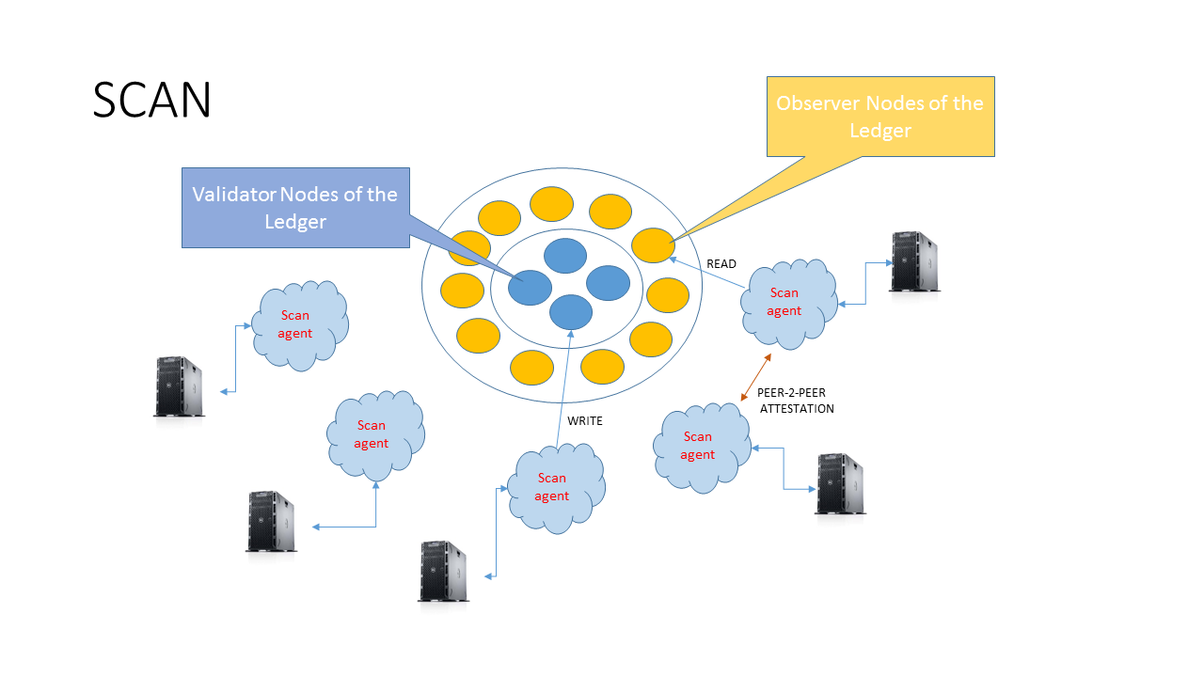

SCAN Services
Provides proofs of Code Commits, open source Usage , open source License based on verified claims raise against public source code repositories.
Uploads Source Code Units
SCAN Services Overview:
  Organization uploads SCU -DIDs
  Claims on DID SCU are verified and self-signed by Validator Nodes & Trust Anchors
  Digital, hashed representation SCU
  Encrypted SCU DIDs will be stored in Blockchain
  When SCU Owners provide consent then the SCU proofs are shared with a 3rd party after digital handshake
Shares SCU DIDs
Request
Claims
SCU DID encrypted and stored in Storage Hub
3rd party
Service providers

Slide 11
Consensus (built-in)
Consensus based on:
  Proof Of Code Commit (POCC)
    Based on Public Code Repositories
  Proof Of open source Usage (POU)
    Based on Verified claims in SCAN ID Hub as usage proof
  Proof Of Applied open source License (POAL)
    Precedence of license made available

Slide 12
Sustaining SCAN
Community driven governance model
Rotation of Foundation Members
Credibility on SCAN
Trust Anchor (Add more participants)
Incentives sharing Proofs
Organize Events, Hack fest to upload public repos
Open source from day one.

Slide 13
SCAN Roll out
M4 : Offer SCAN based Services
Source code Attestation
Repudiation
Validation
M3 : Foundation , Extension and Plugin
Launch Foundation
Community Initiatives
Services Plugins Deduplication
Extend to other Repositories and Existing Tools
Bootstrap SCAN
Expanding SCAN
-Adding Participants
Community Building
- Foundation
- Crowd sourcing
Sustaining
SCAN
- Incentives to organization
- First to disclose
- Claim SCU
SCAN Services
M2 : Develop Client Components
Libraries
CLi’s
APIs
TestNets
Dashboard DApp
M1 : Prototype
SCAN metadata capture
SCAN Connectors, SCAN Agents POCC, POU,POAL
Self attestation, Trust Anchors
SCU DID/DDO on Storage Hub
SCU DID Verification via SCAN

Slide 14
Summary of Benefits
SCAN has the potential to disintermediate the code audit process.
Improves developer productivity.
Decentralized Digital Identity for Source Code
Disclose only what you must about your code with ZKP’s.
Enables better collaboration between organizations
Can put together a world view of open source code giving due credit to original authors and contributors.
.

Slide 15
Thank you…
Vinod Panicker
Distinguished Member Technical Staff -SM
Linkedin/vinodpanicker

Slide 16
Open Source Code Strategy
Open vs Closed source project execution strategies.
Break access barriers , dropping costs to gain competitive edge.
Subscription Models.
Establish Trust and Credibility.
Communities based product delivery and support models.

Slide 17
Foundation
Community Support
Governance
Sustenance
Not for Profit.

Slide 18


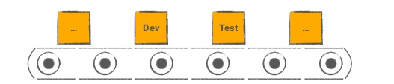
Design Considerations
  Pluggable/Swappable modules.
  API based Access.
  Open source and scales well on commodity hardware.
  Comply with open standards
  Pluggable Block chain components,
  Supports multiple Block chain protocol,
  Common Tool chain for Development, Deployment and Operations for multiple Block chain Frameworks.
Designed
for Crowdsourcing
On Premise
Automated Nodes &
Network
Provisioning
On Cloud

Slide 19
Type of Claims
Has_Duplicate
Has_Usage
Has_Valid_License

Slide 20
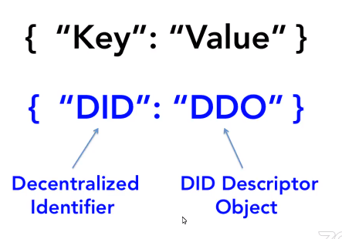
SCU -DID

Slide 21
Open Source Code Management Systems
Fully discover all open source in your code
Monitor and alert when new threats are reported
Map components to known vulnerabilities
Set and enforce open source policies
Seamless integration into your DevOps environment
Identify license and component quality risks

Slide 22
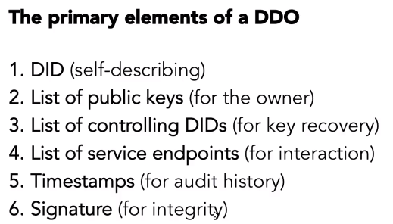
SCU - DDO

Slide 23
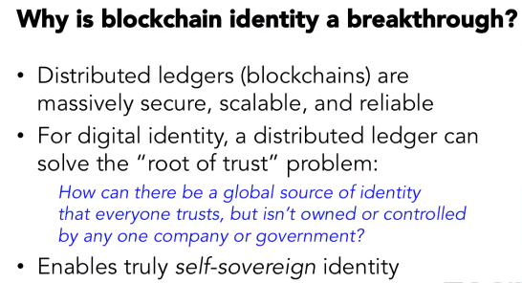
Blockchain Identity

Slide 24
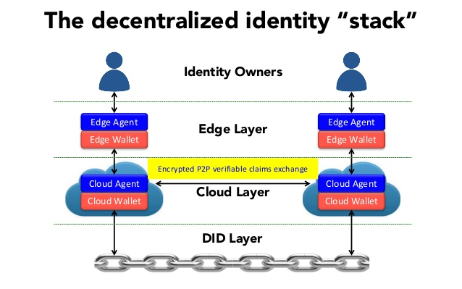
DI Stack

Slide 25
Roadmap
M1 : Prototype
SCAN metadata capture
SCAN Connectors, SCAN Agents POCC, POU,POAL
Self attestation, Trust Anchors
SCU DID/DDO on Storage Hub
SCU DID Verification via SCAN
M3 : Develop Client Components
Libraries
CLi’s
APIs
TestNets
Dashboard DApp
M2 : Foundation , Extension and Plugin
Launch Foundation
Community Initiatives
Services Plugins Deduplication
Extend to other Repositories and Existing Tools
M4 : Offer SCAN based Services
Source code Attestation
Repudiation
Validation

Slide 26
Technologies
Hyperledger project as base Blockchain framework
Distributed Apps: Javascripts Framework, ReactJS
Hybrid Mobile App
DevOps Tool: Ansible/Docker :

