Slide 1
Reputation Management on Blockchain
Wipro Technologies

Slide 2
About the product
A reputation management system on blockchain
Provides an effective digital foot-print on a blockchain based network
The system uses micro transaction of every person as inputs to determine the credibility of a person
The system helps shopkeeper increase the footfall to their shop and also improve their reputation based on number of loans dispensed and collected back.

Slide 3
Why do we need reputation system ?
A significant population doesn’t come under banking sector.
Unavailability of credit to start small businesses
Cost of serving the micro-loan is high
To help people give access to formal line of credit for small finances and business

Slide 4
How do we achieve this ?
Need a unique identity for every person in the system/network, currently which is offered by Aadhar service
Shopkeepers who act as interfaces for dispensing and collecting the micro-loans.
By bringing formal lending authority(bank) or consortium of banks who are willing to participate in the network.
Series of smart contracts on blockchain which make the process trustless, transparent and efficient(user directed)
Using this blockchain as a source of truth for determining reputation

Slide 5
How do I join this network?
Aadhar card
SMS enabled mobile
Bank account
Visit a merchant.
authenticate with Aadhar card.
Send SMS from mobile to get registered.
Receive the private-keys.

Slide 6
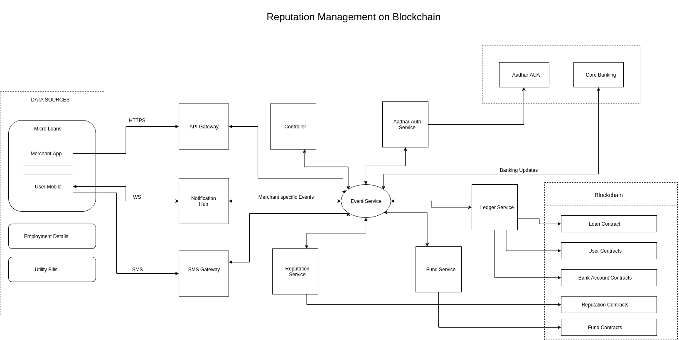
Overview of the architecture

Slide 7
Process/Flows included
User on-boarding
Money Withdrawal
Getting loans
Repaying loans
Reputation management

Slide 8
Contracts
The five major contracts would be deployed to the blockchain network
  User Contracts
  Bank Account Contracts
  Loan Contracts
  Funding Contracts
  Reputation Contracts
User Contracts provides authentication to the other contracts.
Bank Account contracts are representation of bank account on blockchain
Loan Contracts contains the details and conditions for the loans
Fund Contracts encode the rules according to which funds need to be distributed

Slide 9
Reputation Contracts
Since, reputation is a relative parameter, each bank will have its own method of calculating reputation.
Whenever there is a bank transaction the reputation is changed, that is, whenever a loan is taken or loan is paid back reputation of the user is affected.
Reputation will be calculated off-chain based on the rules of the loan providing entity. However, they will receive the inputs from reputation contracts regarding the transactions that needs to be considered while building the reputation.

Slide 10
Challenges
Private-Keys being lost
Handling defaulter's use cases
SMS not reaching users
Preserving user privacy on blockchain

