Slide 1
The Market for Hashes: Economics of cryptocurrencies
Sarthak Gaurav, SJMSOM, IIT B
December 17, 2017
IIT Bombay

Slide 2
Cryptocurrency Market Structure
Oligopoly
- Few players with similar but differentiated products
- Entry barriers
Asset class of Cryptocurrencies
- Store of value
Medium of exchange
Unit of account
Deferring payments

Slide 3
Supply Side
Why “mine” in an inelastic supply?
incentives of participants
Redefining work: algorithms such as PoW
returns to computational effort
welfare loss of different consensus protocols given the mining costs

Slide 4
Demand Side
Too high demand chasing a scarce but useful asset
Investment in computational power and ancillary markets
Price discovery process: frequent cycles
- Transaction demand or Speculative demand?

Slide 5
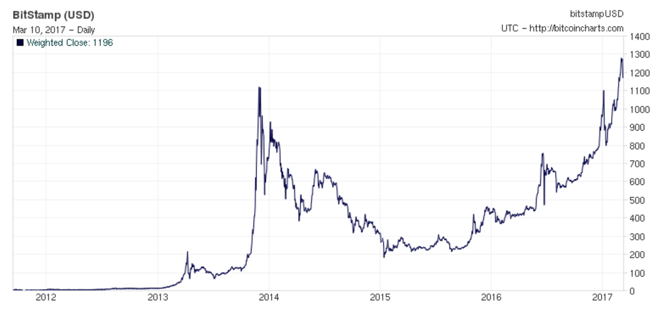
Historical price of bitcoin
Source: https://www.buybitcoinworldwide.com/kb/investing-in-bitcoin/

Slide 6
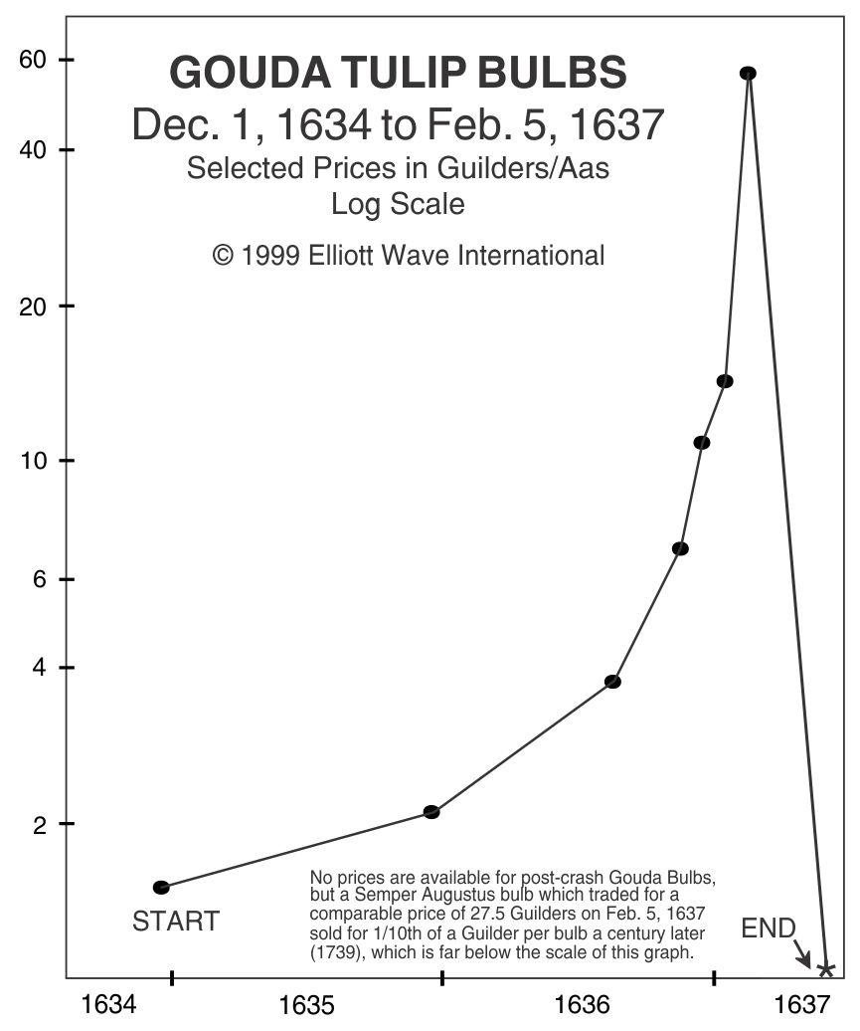
Price Volatility or Mania?
Irrational exuberance
- extraordinary popular delusions and madness of crowds
(Mackay 1841)
Source: http://www.thebubblebubble.com/tulip-mania/

Slide 7
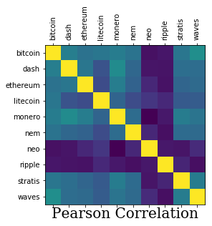
Low cross-cryptocurrency price correlations
Source: https://www.kaggle.com/dbarkhorn/crypto-correlation

Slide 8
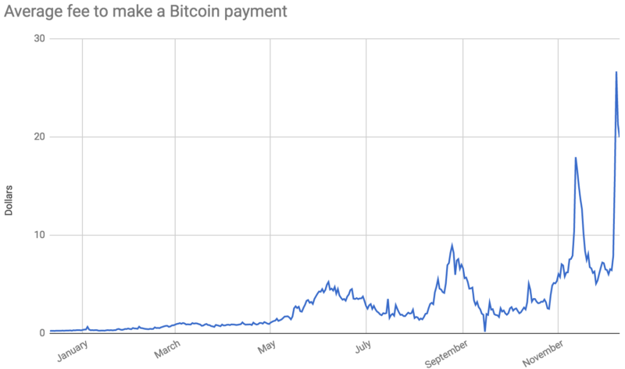
Transaction costs in 2017
Source: Lee (2017)

Slide 9
An ode to Hayek
The Denationalization of Money (1974)
- Govt. monopoly over money is dangerous
- Private sector can print its own currency
…but
Issues: Hoarding, Network (transaction frequency and costs), Stability
Power (computing) dynamics, REGULATION

Slide 10
Way forward
General equilibrium model that incorporates technology features
Optimal design and efficiency of systems

